Slide 1

DSci 185:
Applied Topics in Data Science
Dr. Peter Sentz & Dr. Nathan Gabriel

Slide 2
Agenda
Introductions
CLASS DETAILS
COMPUTING Environment
Installation

Slide 3
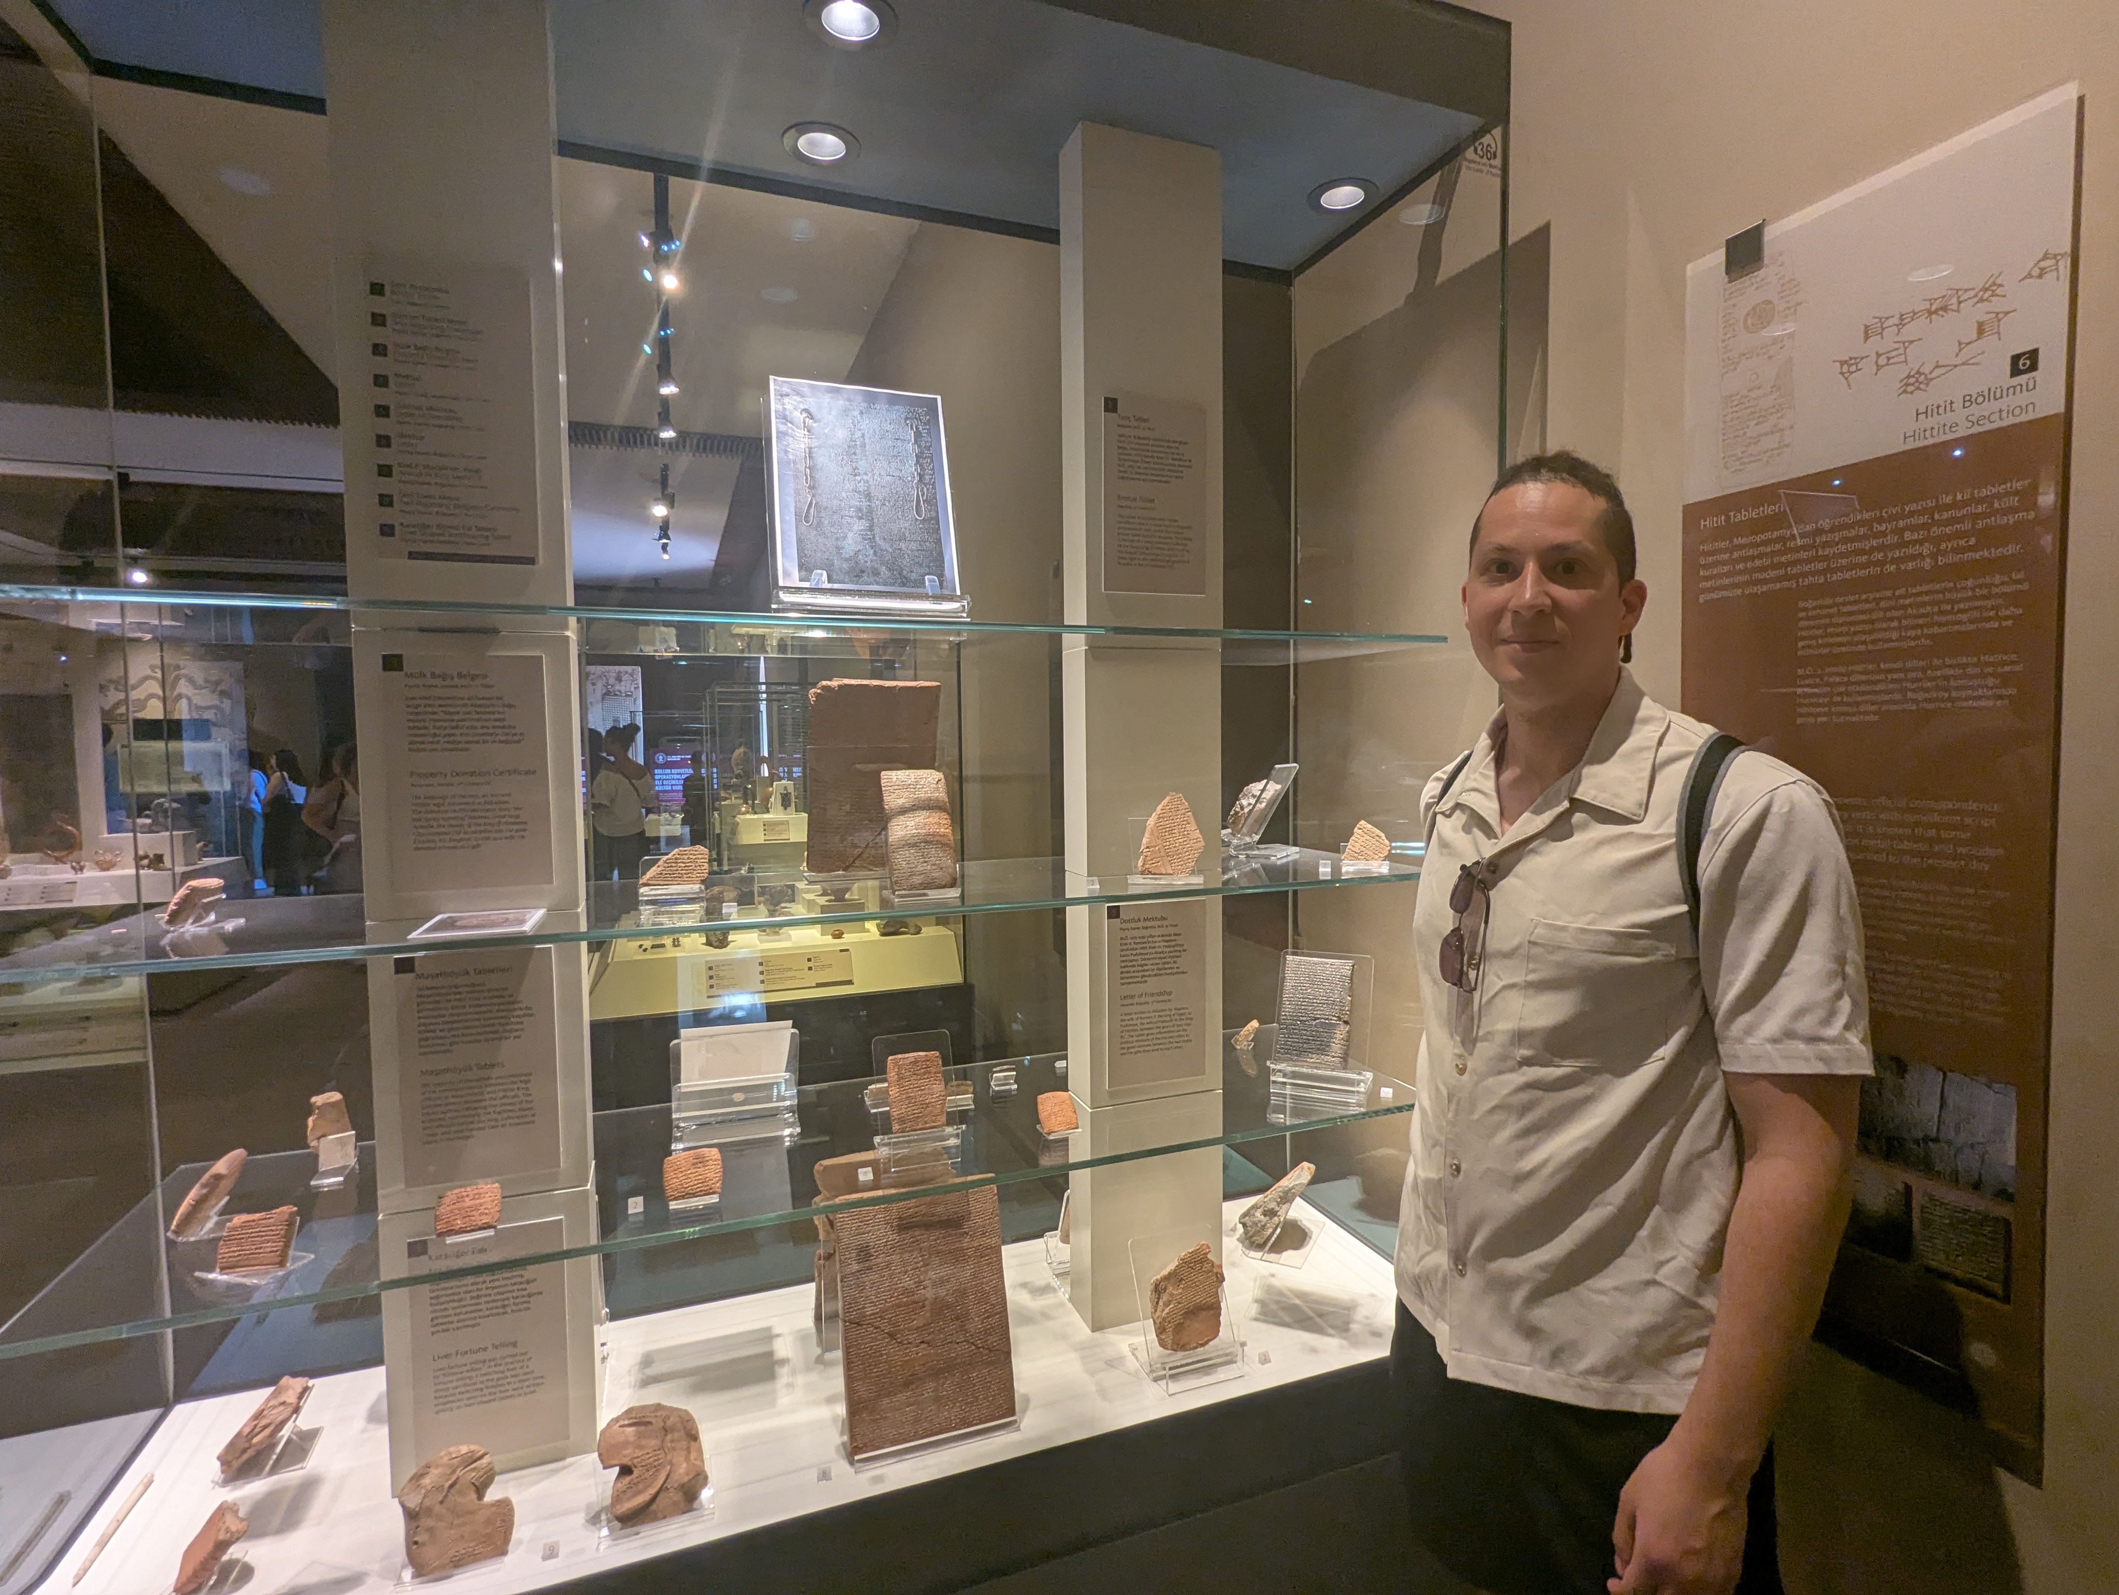
About me
My name is Nathan Gabriel
  You can call me Professor Nathan, Professor Gabriel, Dr. Gabriel or just Professor (when you forget my name)
Academic Background
  Studied Mathematics at Rice University
  Master’s degree in Philosophy at University of Houston
  Master’s degree in Social Science at University of California, Irvine
  PhD in Logic and Philosophy of Science at University of California, Irvine
  Postdoc Cognitive & Information Sciences at University of California Merced
My research background is in the computational approaches to network science and evolutionary game theory, with an emphasis on cultural evolution.

Slide 4


About me
My name is Peter Sentz
  Calling me “Peter” is fine
  If you’re too scared to do that, “Prof. Sentz” or “Dr. Sentz” works as well.
Academic Background
  Studied Mathematics (minoring in Economics) at University of Wisconsin-Milwaukee
  Master’s degree in Applied Mathematics at University of Washington
  PhD in Computer Science at University of Illinois Urbana-Champaign
  Postdoc in Applied Mathematics at Brown University.
  This is my first semester at Emory University
My daughter is two months old today!
My research background is in the numerical solution of differential equations and scientific machine learning.

Slide 5
Teaching Assistants
Maggie Dai
Tucker Sampson
They will be answering questions during our lectures and holding office hours (see Canvas for office hours information).

Slide 6
Agenda
Introductions
CLASS DETAILS
COMPUTING Environment
INSTALLATION

Slide 7
Learning Objectives
Learn how to code effectively in Python and SQL
Learn about key programming principles
Learn how to manipulate and visualize data
For more details and class schedule, review syllabus on course Canvas page!

Slide 8
Grades
Late submissions
Late homework submissions will receive a 5% penalty for every 12 hour period after the due date. After 5 days (120 hours), submissions will receive no credit. Percentages are calculated with respect to the total number of points on the homework (5 points).
To account for unforeseen circumstances, we will drop the worst assignment and the worst quiz
Assignments (x 10): 50%
  Practice class concepts
Quizzes (x5): 30%
  Questions are given in advance
  Data is provided in the class
Final Project: 20 %
  Will provide guidelines on Canvas
  Due at the end of the semester
Midsemester Survey: + 0.5% (Extra)
Final Course Evaluations: + 0.5% (Extra)

Slide 9
Coding ability is not innate
Coding ability can be developed.
Academic skills and abilities are acquired through hard work, mistakes, and perseverance.
My only goal here is that you learn the material. Please ask me questions!

Slide 10
Questions about the logistics

Slide 11
Agenda
Introductions
CLASS DETAILS
COMPUTING Environment
INSTALLATION

Slide 12



Two components:
Virtual Environment
+
Python
VS Code
Integrated Development Environment (IDE)
(in background)
Programming language we use to write the instructions
The “front-end” software that you open every time you code something in Python
A “back-end” software that you install once and hardly open again.

Slide 13

We open script files in VSCode
VS Code
Integrated Development Environment (IDE)
Environment where the user writes the scripts
Script* File
File with code in the Python programming language.
Instructions for the program to follow
* Not really script files. Jupyter Notebook files

Slide 14


Lecture Notes
VS Code
Github:
A file management system in the cloud (with desktop app)
Has version control
Great for collaborative programming

Slide 15

Towards the end of the class we’ll also introduce SQL.
- Advanced database language
- Widely used in industry.
- Can be connected to Python and uses very similar ideas.
More details to come!
+
VS Code

Slide 16
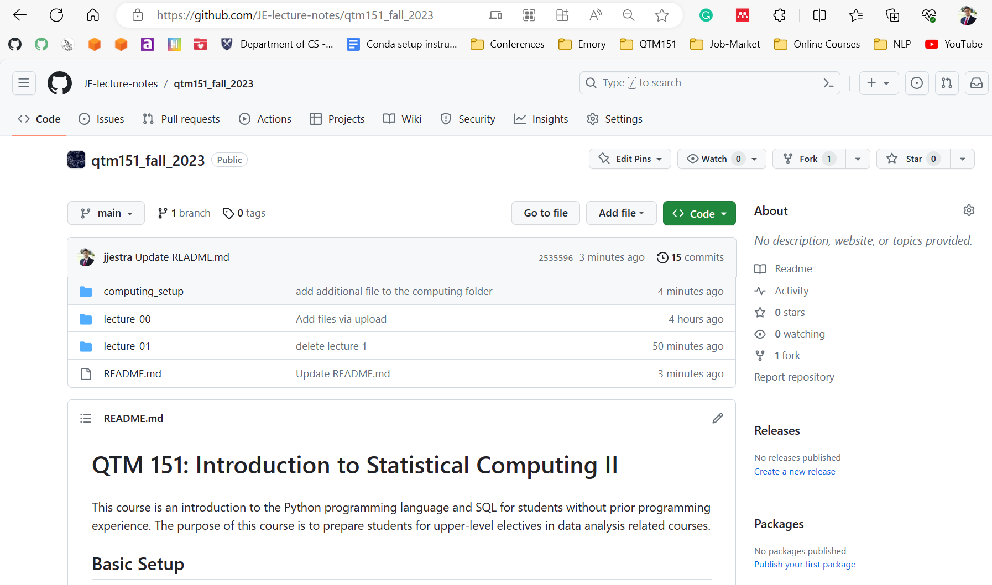
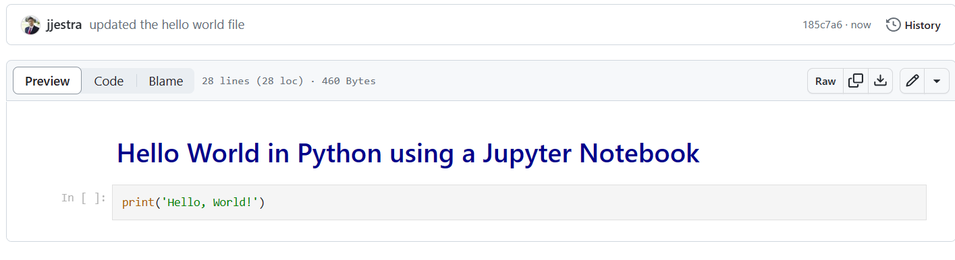
Lecture notes are publicly available at my GitHub website (link posted on Canvas):
https://github.com/sentz2/datasci185fall2026
You can view the lectures in the browser

Slide 17
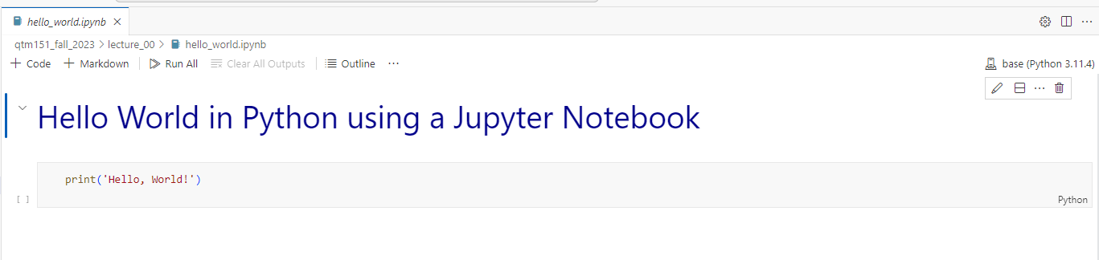
A Jupyter Notebook (“.ipynb”) is a file with code (python) and annotations (markdown)
All the lecture notes are written as Jupyter notebooks
It is encouraged that you bring your laptop to class
Lecture notes are designed to be follow-along. There will be “try it yourself” exercises.

Slide 18
VS Code
See Assignment 1
Basics of a Jupyter notebook
Need to have all the tools installed
Install soon that we can help you with any issues!

Slide 19

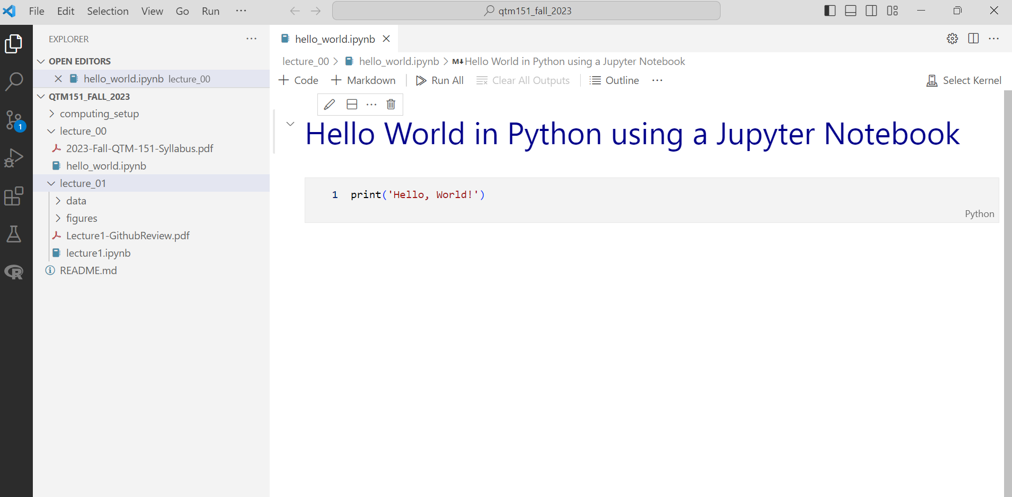
We will do all our coding in Visual Studio Code
Python
“.ipynb”: Interactive Python Notebook
Lecture notes

Slide 20
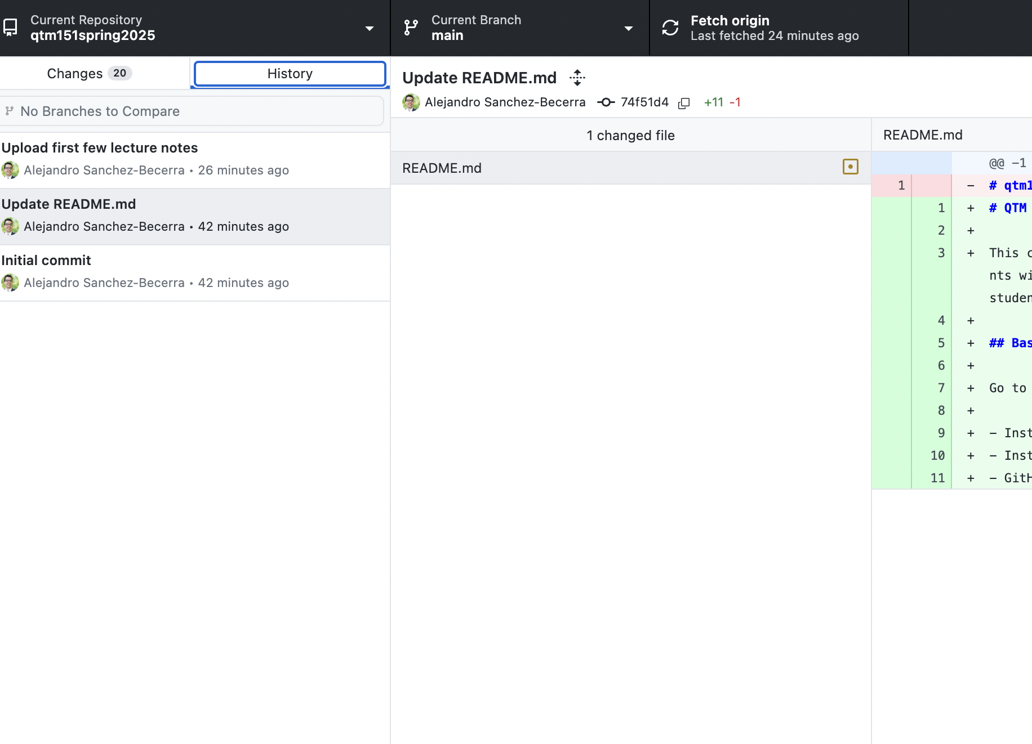
Github Desktop will allow you to automatically download the lectures notes from my account (and update them).
It will also show you
the date of any update
what the changes are
Update the lecture notes before class!

Slide 21
Questions about computing environment?

Slide 22
Agenda
Introductions
CLASS DETAILS
COMPUTING Environment
INSTALLATION

Slide 23
Let’s get started!
Go to “Modules” in Canvas and open the documents under “Installation” and follow instructions.
We will walk around to answer questions.
If you don’t complete the installation, we encourage you to visit one of the office hours, so that you are set up before the next class.

